Slide 1
Distributed Multi-Robot Exploration in a GPS-Denied Environment
Kevin Sheridan
AAE, sheridak@purdue.edu
AAE 590 Course Project, Instructor: Shaoshuai Mou

Slide 2
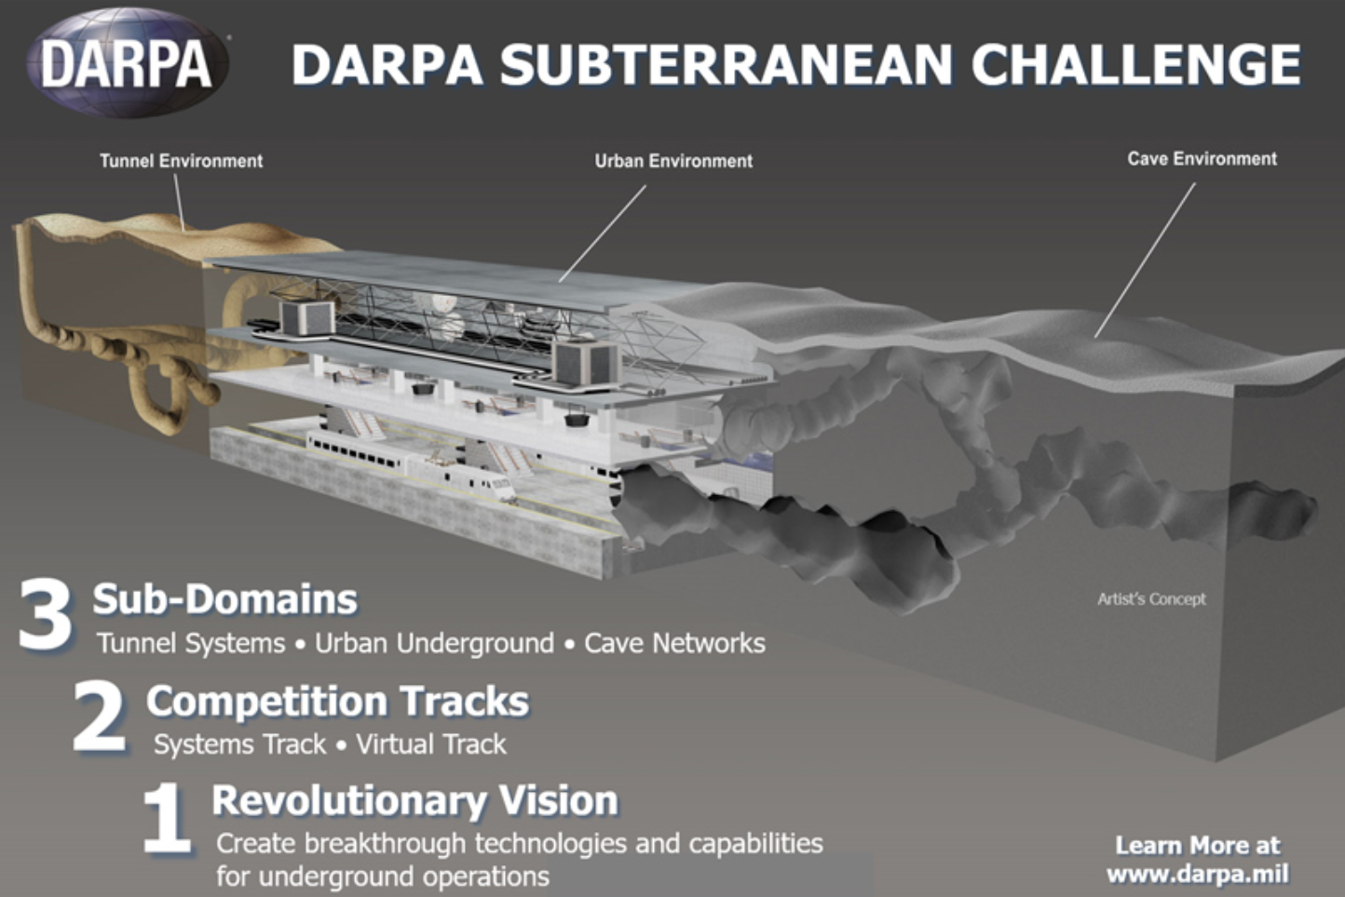
Motivation
Distributed multi-robot exploration in a GPS-denied environment allows
More area coverage than a single robot is capable of.
Redundancy to failures and/or hazardous environments.
The ability for the exploration to be carried out in any area.
No special communication infrastructure or special setup is required.

Slide 3
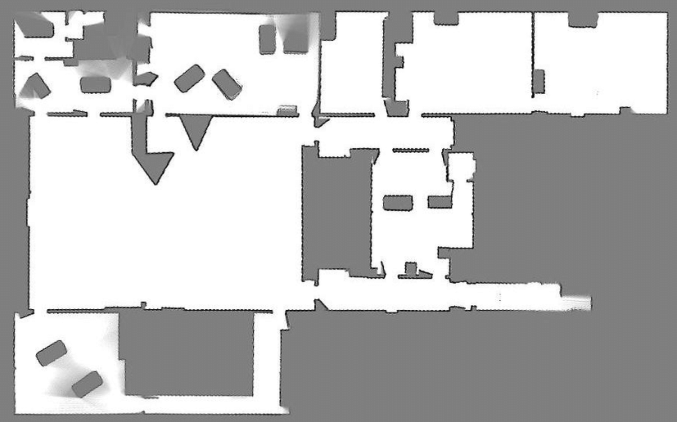
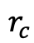
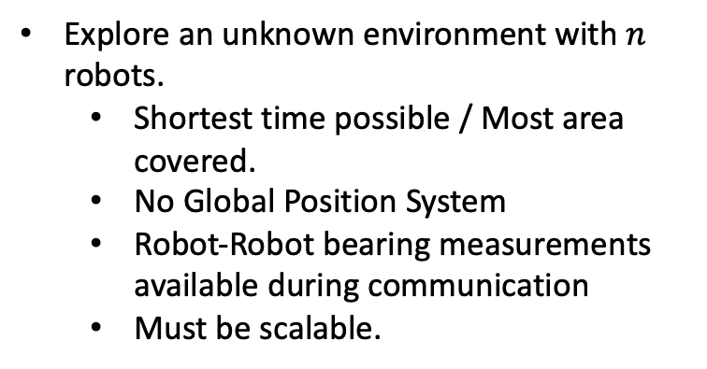
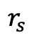
Problem Formulation
Explore an unknown environment with $n$ robots.
Shortest time possible / Most area covered.
No Global Position System
Robot-Robot bearing measurements available during communication
Must be scalable.
$$r_{c}$$
$$r_{s}$$
Occupancy Grid From Capobianco, Roberto. (2017). Interactive Generation and Learning of Semantic-Driven Robot Behaviors.

Slide 4
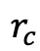
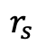
$$r_{c}$$
$$r_{s}$$
Occupancy Grid From Capobianco, Roberto. (2017). Interactive Generation and Learning of Semantic-Driven Robot Behaviors.

Slide 5

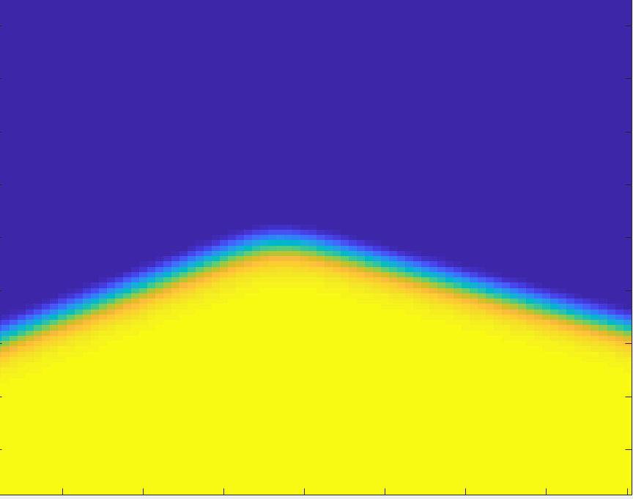
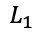
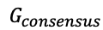
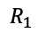
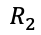
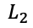
Key Idea & Proposed Approaches
Biased Frontier-Based Exploration
During robot interactions, both robots select a potential function defined in a global frame.
Frontiers which minimize this potential function are chosen.
Global Frame Consensus
In order to define the frontier potential functions, a common frame must be found.
Distributed Averaging with periodic gossiping is used.
$$L_{1}$$
$$G_{consensus}$$
$$R_{2}$$
Global Potential Function
$$L_{2}$$
$$θ$$
$$R_{1}$$

Slide 6
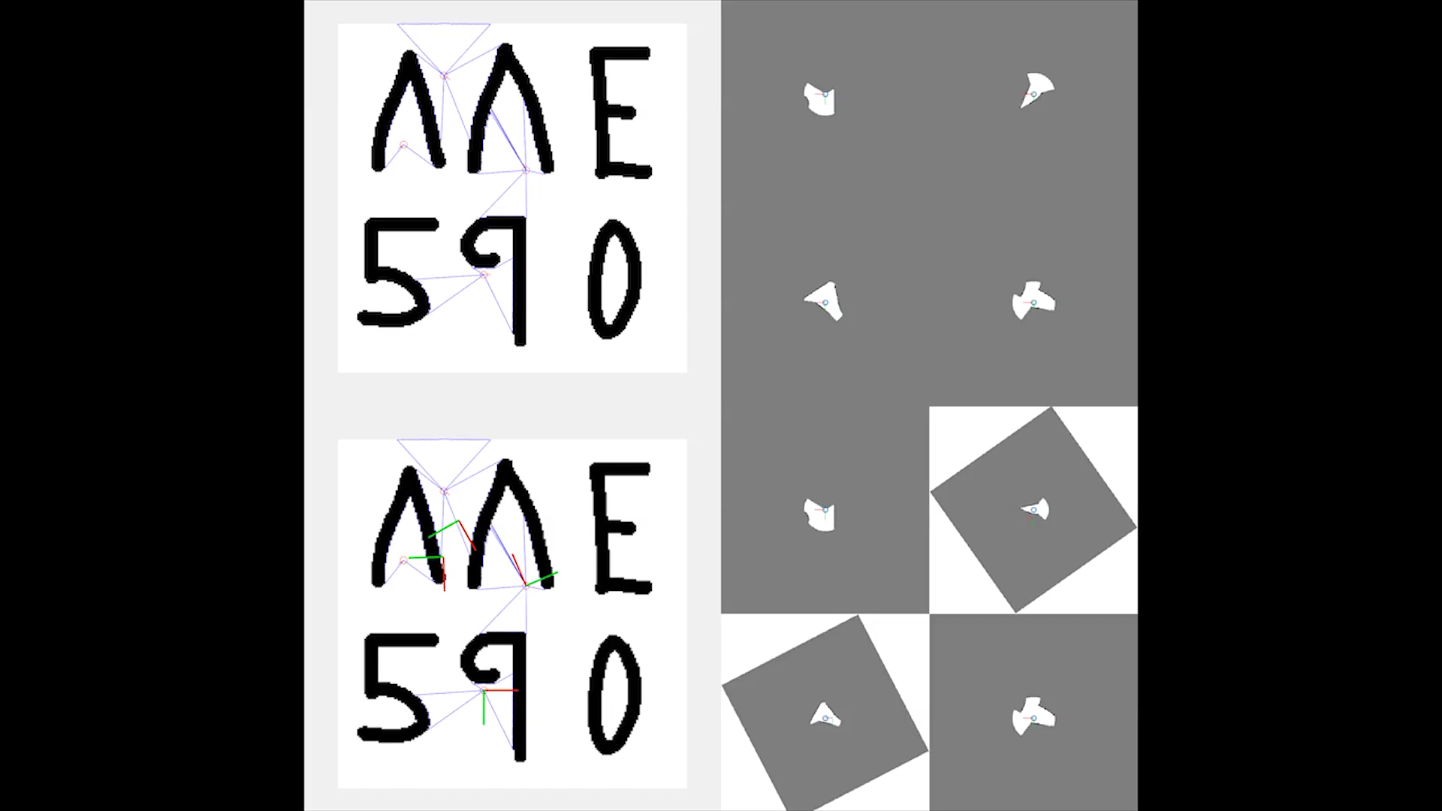
Main Result & Simulations

Slide 7
Future Work
Incorporate Uncertainty into the global frame consensus.
Use a quadtree defined in the common frame to efficiently relay exploration progress.
Generalize to 6 degrees of freedom.

